Slide 1
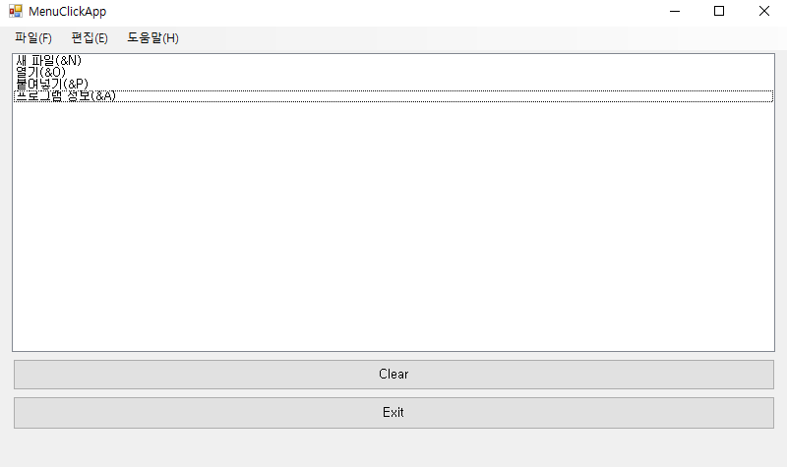
namespace _0524Form
{
public partial class Form1 : Form
{
public Form1()
{
InitializeComponent();
}
private void 닫기CToolStripMenuItem_Click(object sender, EventArgs e)
{
Close();
}
private void 종료XToolStripMenuItem_Click(object sender, EventArgs e)
{
Close();
}
private void button1_Click(object sender, EventArgs e)
{
listBox1.Items.Clear();
}

Slide 2
private void button2_Click(object sender, EventArgs e)
{
Application.Exit();
}
private void 새파일NToolStripMenuItem_Click(object sender, EventArgs e)
{
listBox1.Items.Add(((ToolStripMenuItem)sender).Text);
}
private void 열기OToolStripMenuItem_Click(object sender, EventArgs e)
{
listBox1.Items.Add(((ToolStripMenuItem)sender).Text);
}
private void 붙여넣기PToolStripMenuItem_Click(object sender, EventArgs e)
{
listBox1.Items.Add(((ToolStripMenuItem)sender).Text);
}
private void 프로그램정보AToolStripMenuItem_Click(object sender, EventArgs e)
{
listBox1.Items.Add(((ToolStripMenuItem)sender).Text);
}
}
}

Slide 3
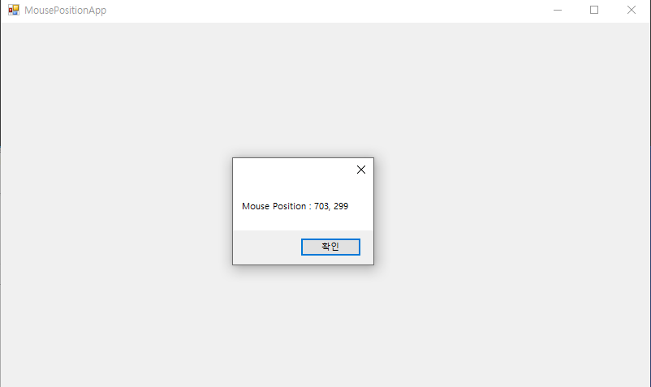
namespace MouseHandle
{
public partial class Form1 : Form
{
public Form1()
{
InitializeComponent();
}
private void Form1_MouseEnter(object sender, EventArgs e)
{
Point mousePoint = PointToClient(MousePosition);
string msg = "Mouse Position : " + mousePoint.X + ", "
+ mousePoint.Y;
MessageBox.Show(msg);
}
}
}

Slide 4
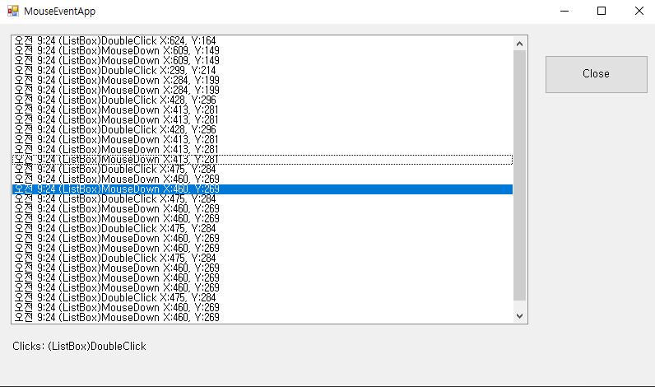
namespace MouseHandeler2
{public partial class Form1 : Form
{public Form1()
{initializeComponent();}
private void UpdateEventLabels(string msg, int x, int y,
MouseEventArgs e)
{string message = string.Format("{0} X:{1}, Y:{2}", msg, x, y);
string eventMsg = DateTime.Now.ToShortTimeString();
eventMsg += " " + message;
listBox1.Items.Insert(0, eventMsg);
listBox1.TopIndex = 0;
string mouseInfo;
if (e != null)
{mouseInfo = string.Format("Clicks: {0}, Delta: {1}, " +
"Buttons: {2}", e.Clicks, e.Delta,
e.Button.ToString());}
else
{mouseInfo = string.Format("Clicks: {0}", msg);}
label1.Text = mouseInfo;}

Slide 5
private void listBox1_MouseDown(object sender, MouseEventArgs e)
{
UpdateEventLabels("(ListBox)MouseDown", e.X, e.Y, e);
}
private void listBox1_DoubleClick(object sender, EventArgs e)
{
Point mousePoint = PointToClient(MousePosition);
UpdateEventLabels("(ListBox)DoubleClick",
mousePoint.X, mousePoint.Y, null);
}
private void button1_Click(object sender, EventArgs e)
{
Application.Exit();
}
}
}

Slide 6
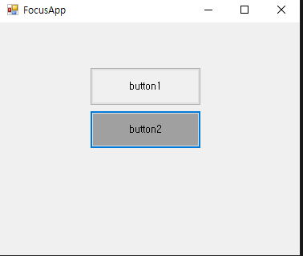
namespace Focus
{ public partial class Form1 : Form
{public Form1()
{InitializeComponent();}
private void button1_Click(object sender, EventArgs e)
{this.button1.BackColor = SystemColors.Control;
this.button2.Focus();
if (this.button2.Focused)
this.button2.BackColor = SystemColors.ControlDark;}
private void button2_Click(object sender, EventArgs e)
{this.button2.BackColor = SystemColors.Control;
this.button1.Focus();
if (this.button1.Focused)
this.button1.BackColor = SystemColors.ControlDark;} }}

Slide 7
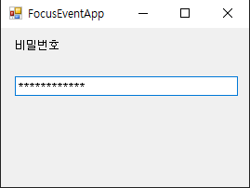
namespace Focus2
{
public partial class Form1 : Form
{
public Form1()
{
InitializeComponent();
}
private void textBox1_Enter(object sender, EventArgs e)
{
}
}
}

Slide 8
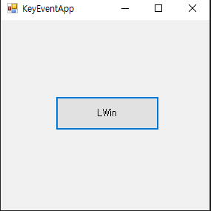
namespace KeyEvent
{public partial class Form1 : Form
{ public Form1()
{InitializeComponent();}
public int xPt, yPt;
public static readonly int MOVE = 10;
private void button1_KeyUp(object sender, KeyEventArgs e)
{this.xPt = this.button1.Location.X;
this.yPt = this.button1.Location.Y;
switch (e.KeyCode)
{case Keys.Left:
xPt -= MOVE; break;
case Keys.Right:
xPt += MOVE; break;
case Keys.Up:
yPt -= MOVE; break;
case Keys.Down:
yPt += MOVE; break;}
this.button1.Text = e.KeyCode.ToString();
this.button1.Location = new Point(xPt, yPt);}}}

Slide 9
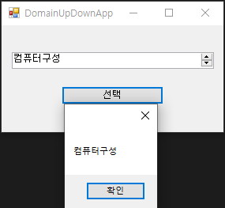
namespace UpDown
{
public partial class Form1 : Form
{
public Form1()
{
InitializeComponent();
}
private void button1_Click(object sender, EventArgs e)
{
MessageBox.Show(domainUpDown1.SelectedItem.ToString());
}
}
}

Slide 10
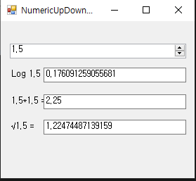
namespace Numeric
{
public partial class Form1 : Form
{
public Form1()
{
InitializeComponent();
}
private void numericUpDown1_ValueChanged(object sender, EventArgs e)
{
decimal d = numericUpDown1.Value;
label1.Text = "Log " + d + " = ";
textBox1.Text = System.Math.Log10((double)d).ToString();
label2.Text = d + "*" + d + " = ";
textBox2.Text = System.Math.Pow((double)d, 2).ToString();
label3.Text = "√" + d + " = ";
textBox3.Text = System.Math.Sqrt((double)d).ToString();
}
}
}

Slide 11
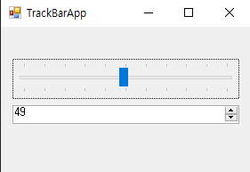
namespace Track
{
public partial class Form1 : Form
{
public Form1()
{
InitializeComponent();
}
private void trackBar1_Scroll(object sender, EventArgs e)
{
numericUpDown1.Value = trackBar1.Value;
}
private void numericUpDown1_ValueChanged(object sender, EventArgs e)
{
trackBar1.Value = (int)numericUpDown1.Value;
}
}
}

Slide 12
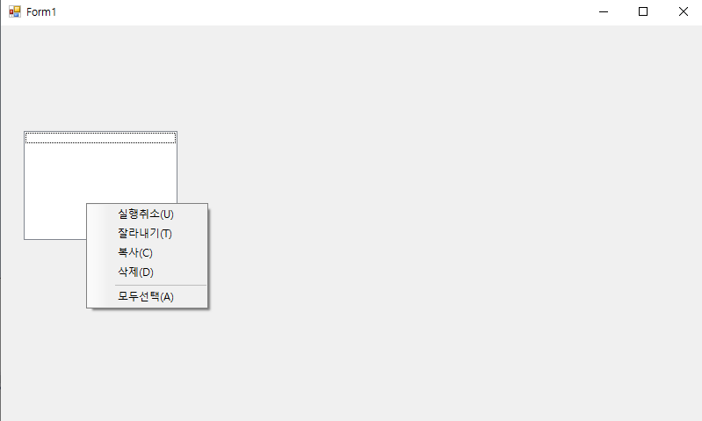
namespace ContextMenu
{
public partial class Form1 : Form
{
public Form1()
{
InitializeComponent();
}
private void contextMenuStrip1_Opening(object sender, CancelEventArgs e)
{
}
private void Form1_Load(object sender, EventArgs e)
{
}
}
}

